Slide 1
Computer Evolution
Yuemin Ding
Tecnun, University of Navarra
Fall, 2021

Slide 2
Outline
1st generation computer
2nd generation computer
3rd generation computer
4th~present generations computer
Moore’s Law

Slide 3
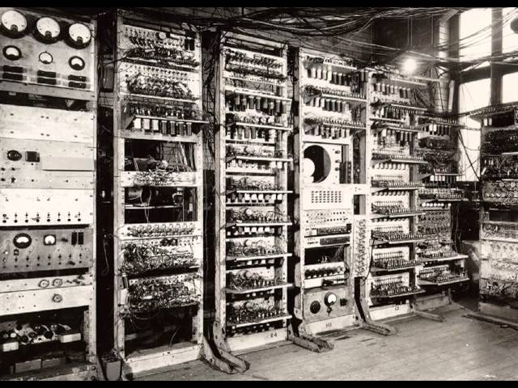
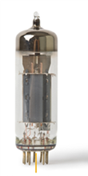
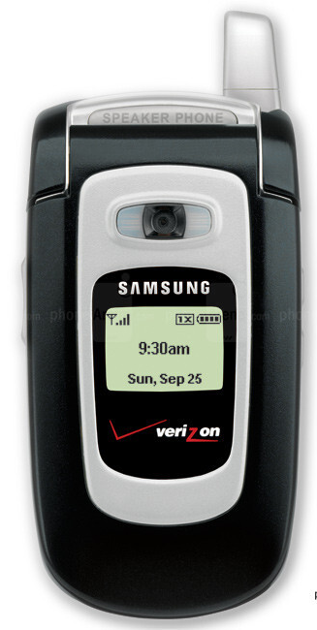
The 1st Generation: Vacuum Tubes
ENIAC - background
  World’s first programmable, general purpose, electronic digital computer
  Finished by Mauchly and Eckert at University of Pennsylvania, in 1946
  Used until 1955: feasibility of the hydrogen bomb
× 1300 ≈
Notes:
http://www.antiquetech.com/?page_id=1438

Slide 4
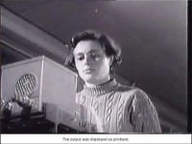
The 1st Generation: Vacuum Tubes

Slide 5
Outline
1st generation computer
2nd generation computer
3rd generation computer
4th~present generations computer
Moore’s Law

Slide 6

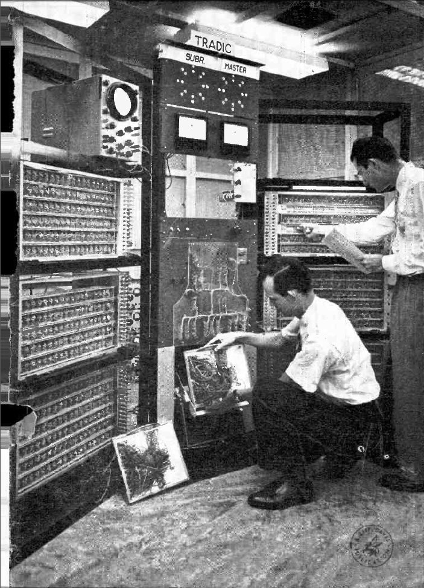
The 2nd Generation: Transistors
The first major change: transistors replaced vacuum tubes. Major advantages:
  Smaller
  Cheaper
  Less heat dissipation
Solid State device: made from Silicon (Sand)
Invented 1947 at Bell Labs

Slide 7
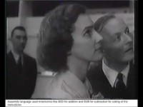
The 2nd Generation: Transistors

Slide 8
Outline
1st generation computer
2nd generation computer
3rd generation computer
4th~present generations computer
Moore’s Law

Slide 9
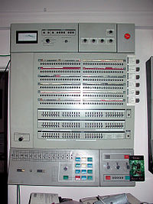
The 3rd Generation
Microelectronics:
  Literally - “small electronics”
  A computer is made up of gates, memory cells and interconnections
  These can be manufactured on a semiconductor
  Examples: IBM System 360

Slide 10
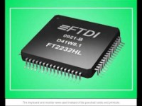
The 3rd Generation

Slide 11
Outline
1st generation computer
2nd generation computer
3nd generation computer
4th~present generations computer
Moore’s Law

Slide 12
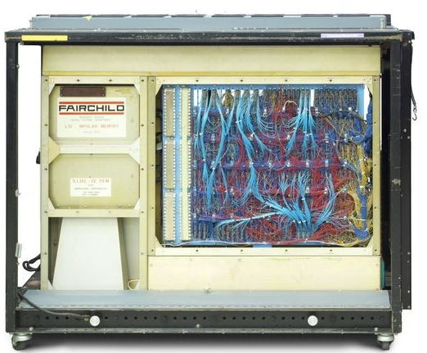
The 4th Generation
Semiconductor Memory
  The same technology for constructing the processor is also applied to the memories.
  1970, Fairchild produced the first semiconductor memory

Slide 13
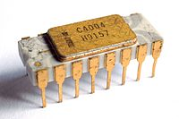
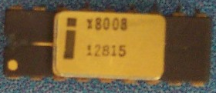
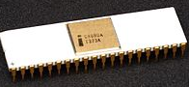
The 4th Generation
1971 – Intel 4004
  First microprocessor
  All CPU components on a single chip
  4 bit
Followed in 1972 by 8008
  8 bit
  Both designed for specific applications
1974 - 8080
  Intel’s first general purpose microprocessor
  8 bit

Slide 14
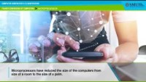
The 4th Generation

Slide 15

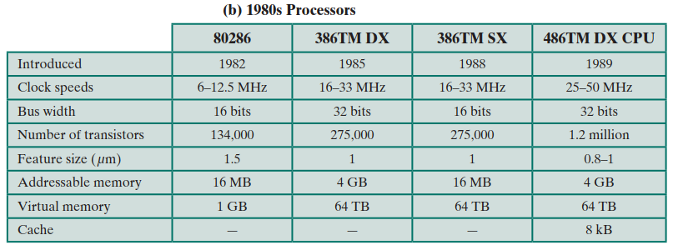
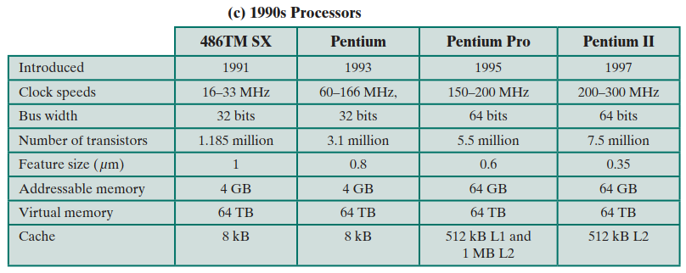
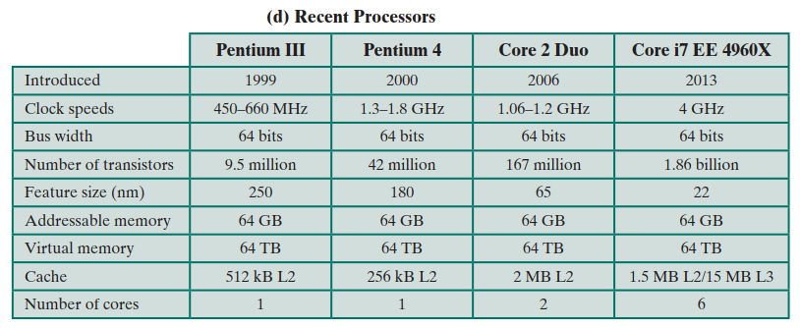
Microprocessors - Intel

Slide 16
Summary: Generations of Computer
1st Generation: Vacuum tube - 1946-1956
2nd Generation: Transistor - 1957-1964
3rd Generation: Microelectronics
  SSI: Small scale integration - 1965 on
    Up to 100 components on a chip
  MSI: Medium scale integration - to 1971
    100-3,000 components on a chip
4th Generation:
  LSI: Large scale integration - 1971-1977
    3,000 - 100,000 components on a chip
5th Generation:
  VLSI: Very large scale integration - 1978 -1991
    100,000 - 100,000,000 components on a chip
6th Generation:
  ULSI: Ultra large scale integration – 1991 -
    Over 100,000,000 components on a chip

Slide 17
Outline
1st generation computer
2nd generation computer
3rd generation computer
4th generation computer
Moore’s Law

Slide 18
Moore’s Law
Increased density of components on chip
Gordon Moore – co-founder of Intel
Number of transistors on a chip will double every year
Since 1970’s development has slowed a little
  Number of transistors doubles every 18 months
Cost of a chip has remained almost unchanged
Higher packing density means shorter electrical paths, giving higher performance
Smaller size gives increased flexibility
Reduced power and cooling requirements
Fewer interconnections increases reliability

Slide 19
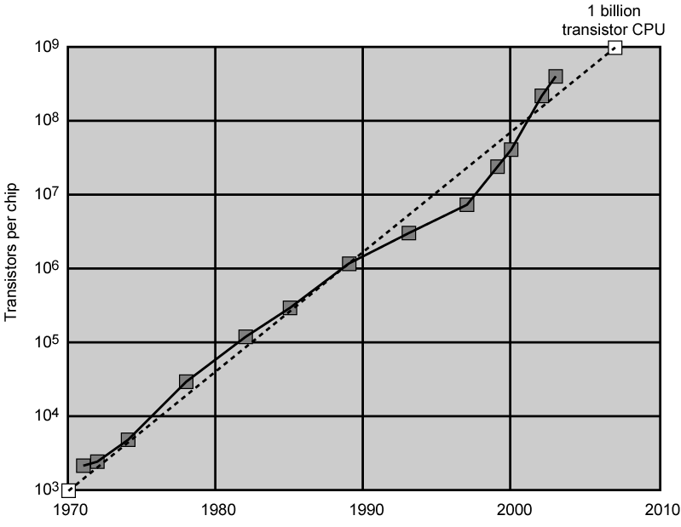
Growth in CPU Transistor Count

Slide 20
Thank you!
Q&A

